Slide 1
Family & Consumer Sciences
Southern Region
Capacity Mapping Project
Alabama, Arkansas, Florida, Georgia, Kentucky, Louisiana, Mississippi, North Carolina, Oklahoma, South Carolina, Tennessee, Texas, Virginia

Slide 2
What is a map?
A generalized view of an area, usually some portion of Earth’s surface, as seen from above at a greatly reduced size
Any geographical image of the environment
A two-dimensional representation of the spatial distribution of selected phenomena
Retrieved from www.csus.edu 8.16.2016

Slide 3
Why make maps?
To represent a larger area than we can see
To show a phenomenon or process we can’t see with our eyes
To present information concisely
To show spatial relationships
Retrieved from www.csus.edu 8.16.2016

Slide 4
Why make maps?
To represent a larger area than we can see
To show a phenomenon or process we can’t see with our eyes
To present information concisely
To show spatial relationships
Retrieved from www.csus.edu 8.16.2016

Slide 5
Family & Consumer Sciences Why Focus On Maps?
Inspiration for maps is from the Community Commons website.
Visualizations would be useful to FCS in many ways:
Write down your ideas as to how we could use these maps to advance FCS

Slide 6
Retrieved from wdcstudioapps.esri.com 8.22.2016

Slide 7
Retrieved from wdcstudioapps.esri.com 8.22.2016

Slide 8
Retrieved from wdcstudioapps.esri.com 8.22.2016

Slide 9
Retrieved from wdcstudioapps.esri.com 8.22.2016

Slide 10
Retrieved from storymaps.blueraster.com 8.22.2016

Slide 11
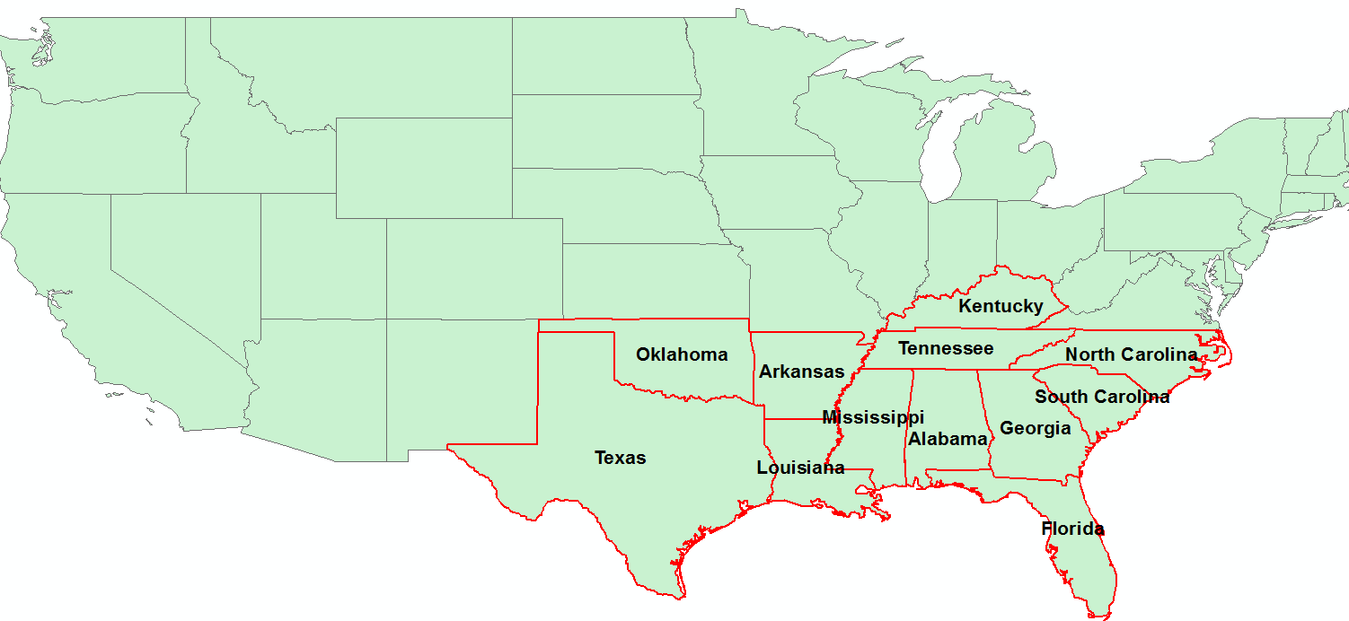
Southern States
West VA

Slide 12
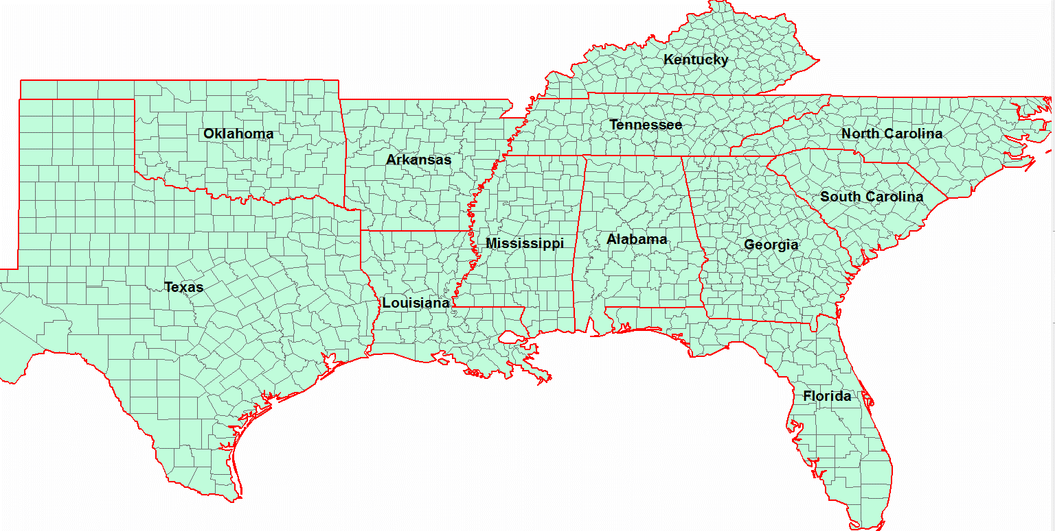
Counties in Southern States
West VA

Slide 13
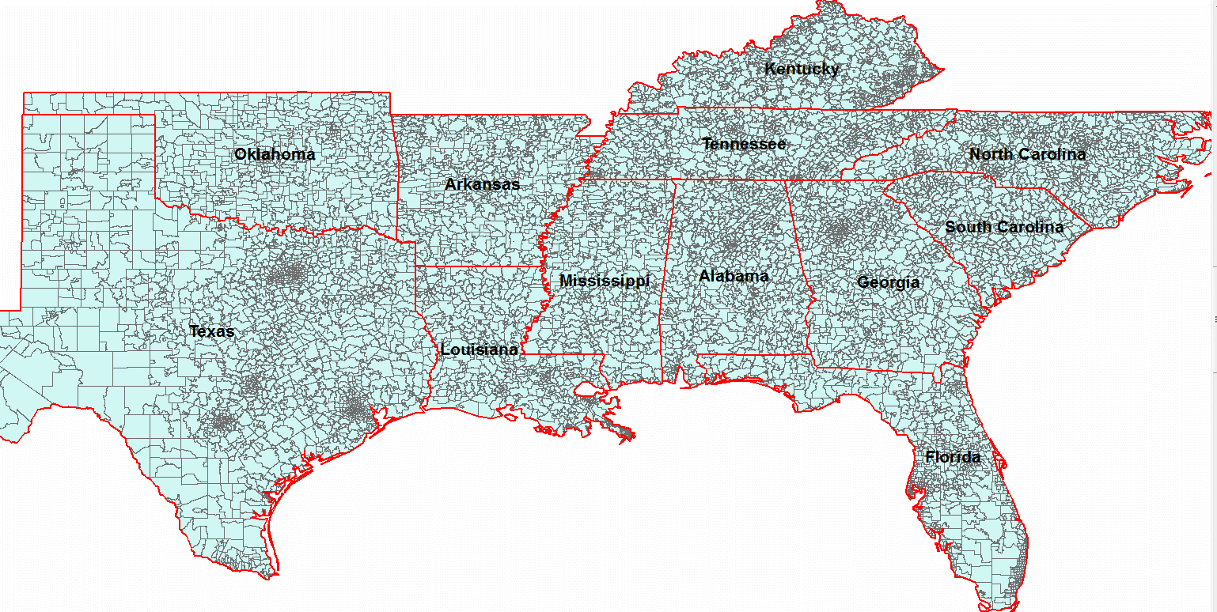
Zip Codes in Southern States
West VA

Slide 14
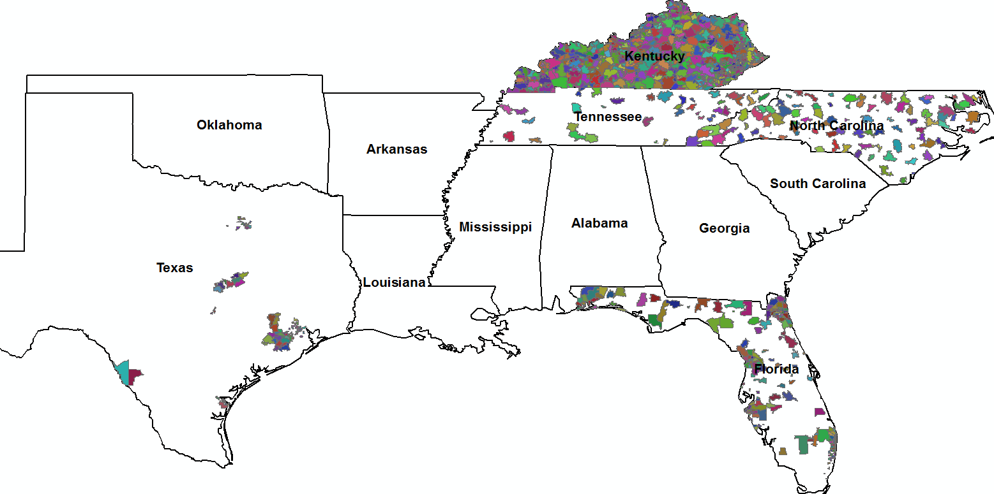
Zip Codes With FCS Programs
West VA

Slide 15
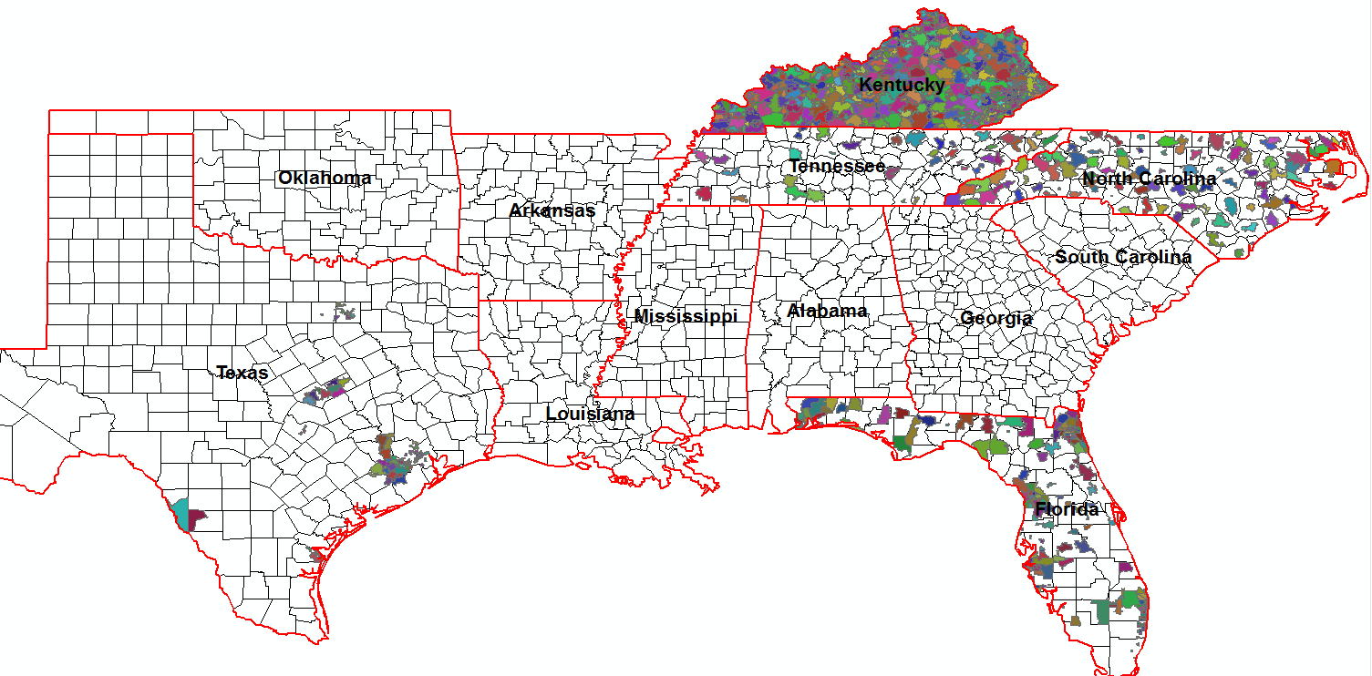
Counties and Zip Codes With FCS Programs
West VA
Note: Data of KY shows that they are serving all counties and associated zip codes

Slide 16
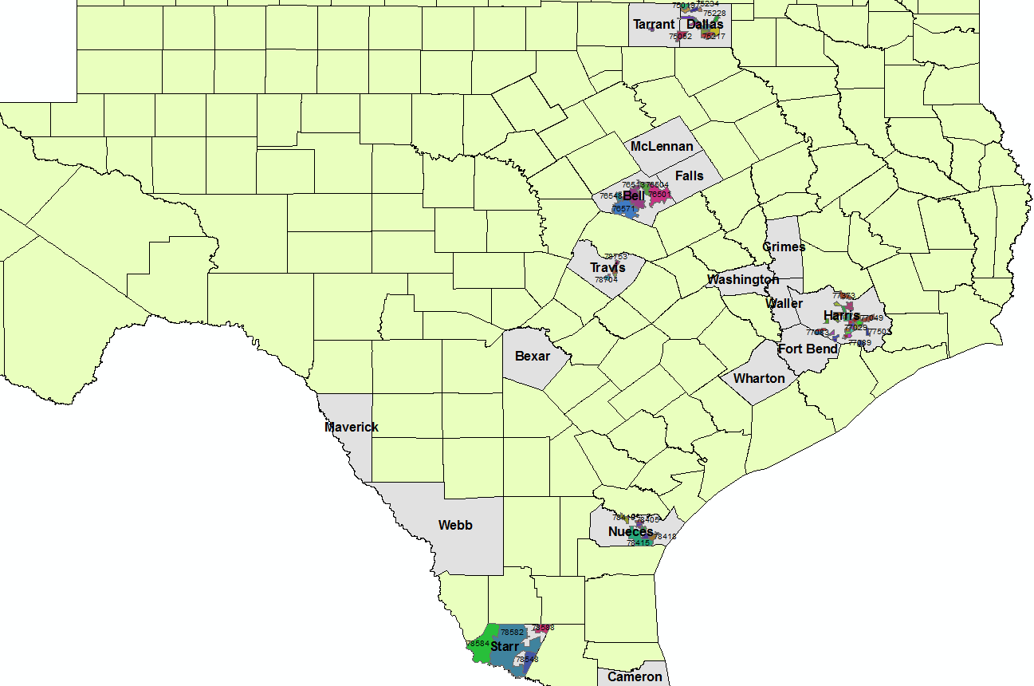

Slide 17
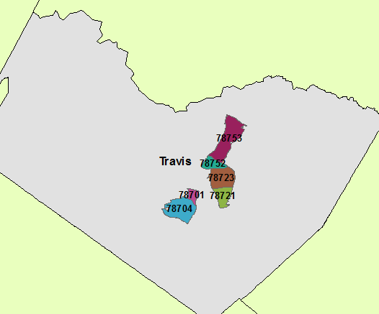
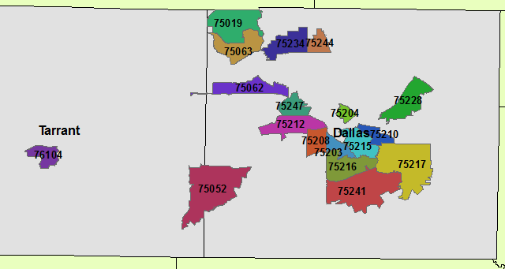
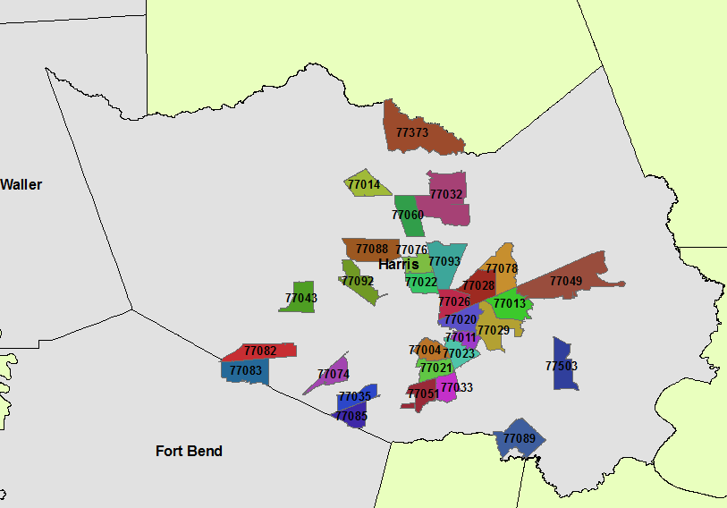
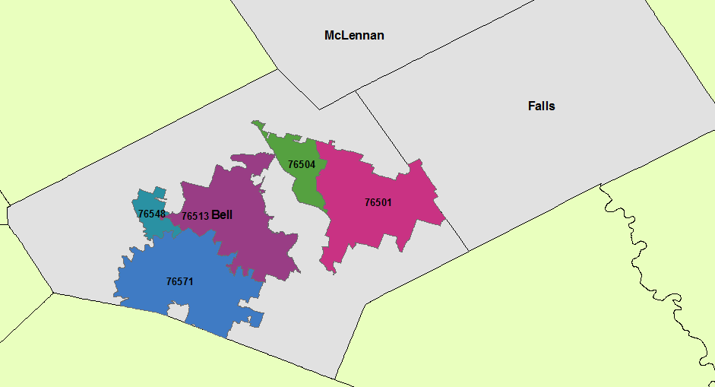
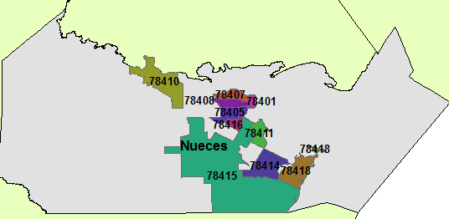

Slide 18
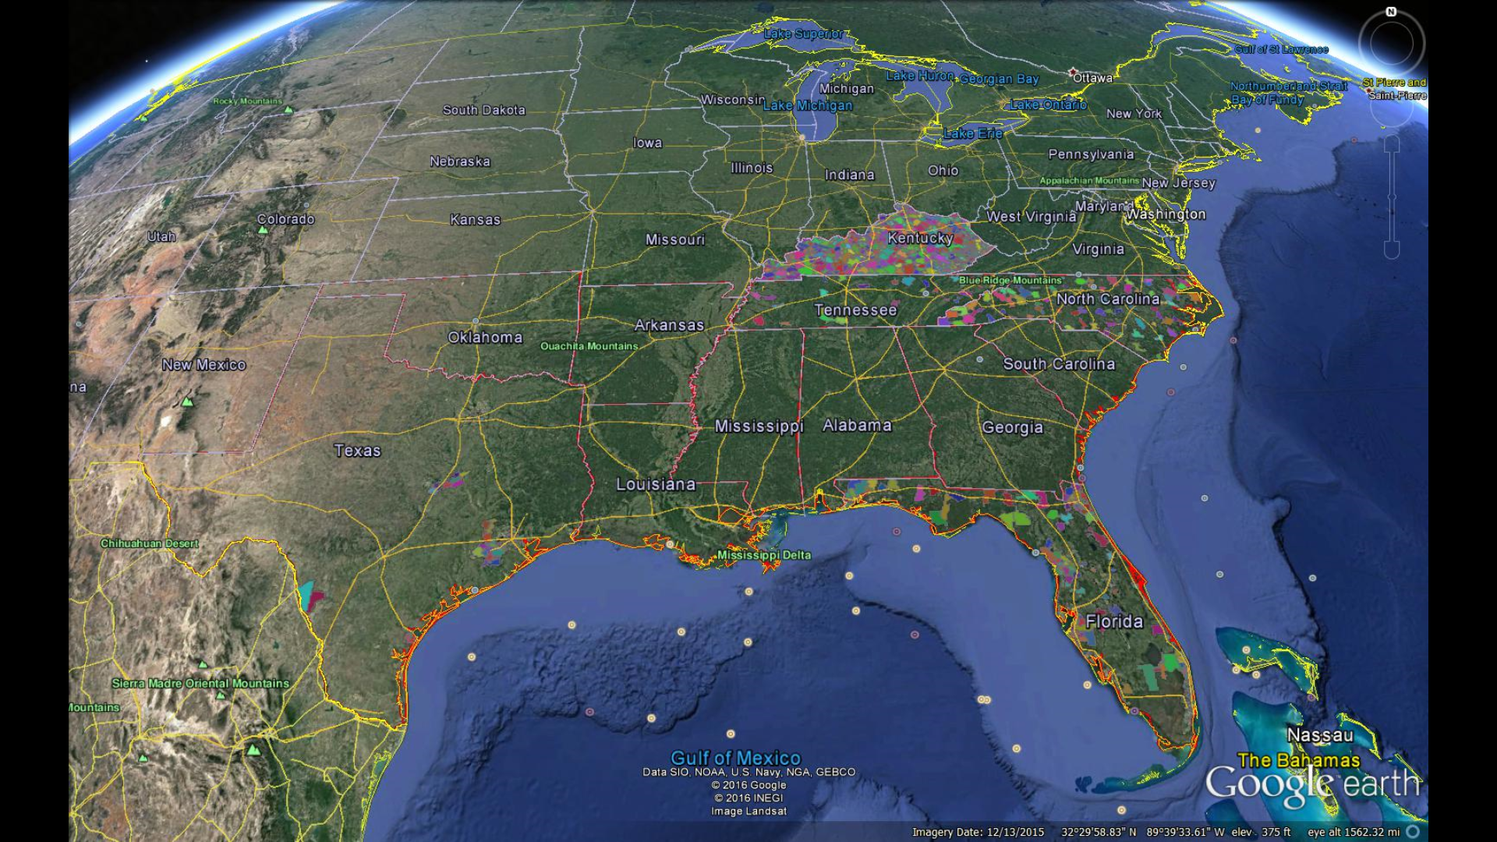
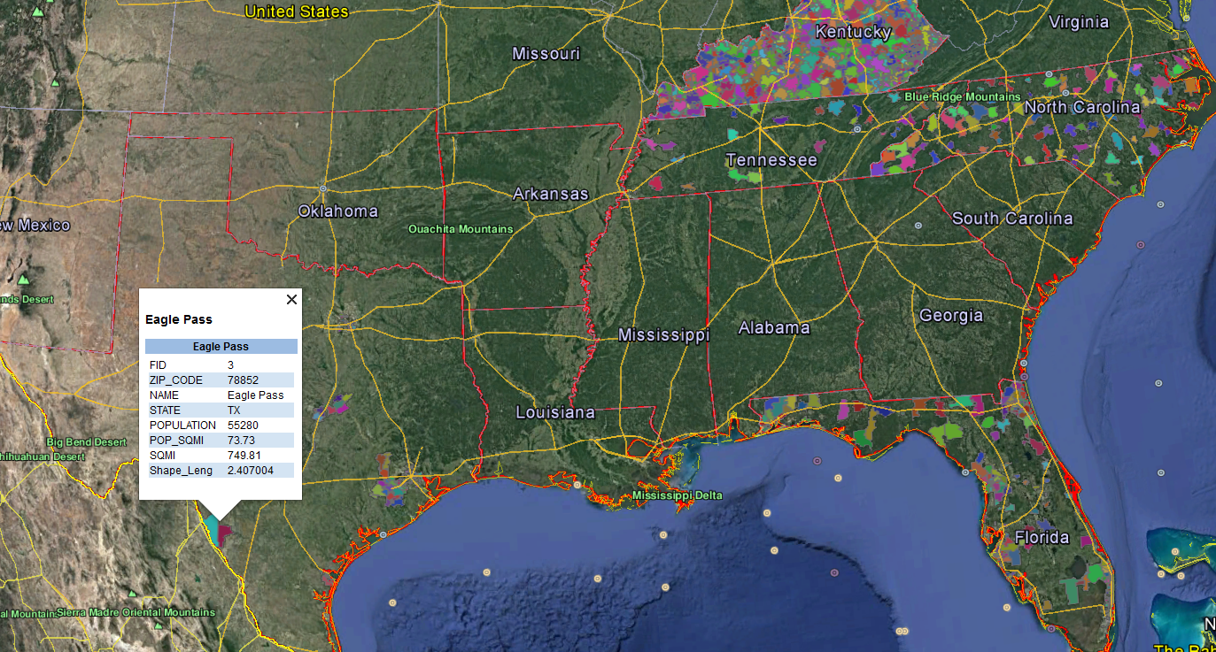
Zip Codes With FCS Programs on Google Earth
If you view this map on Google Earth, it would be easy to look at all the associated information of that particular zip codes just by clicking on it.

Slide 22
Time To THINK out of the Box

Slide 23
Action Ideas
What percentage are FCS grant funded positions vs state/local funded? Is the capacity mostly on soft funded $
County population – reallocation of personnel
Partnering with others – across state, within state with other organizations
Potential for Impact vs our capacity– what are we doing and where are we succeeding (Esp 1890) using the data
Use of existing data to direct and build programs
FCS economic value on our education outreach – What data can we show?

Slide 24
Continued Ideas #1
Market specific programs to specific audiences
Decisions where we are working vs where we could/should be related to needs identification
Show decision-makers where we are – we are trying to make a difference.
Plan needs and partners with resources
Capacity of multi-state projects – defining gaps, opportunities
Training focus for specific programs where needs exist
Multi county approaches – this could map where potential audiences/FCS resources are located (facilitate cross county work)

Slide 25
Continued ideas #2
Mapping what commodities are grown in the state/farmers market sites/etc. – Nutrition educators could then point clientele to resources
Capacity mapping can tell a state and collective multi-state/regional story
Use as a marketing tool
Health data overlays with our capacity/resources (ie high A1C, Housing/price changes/bankruptcy/etc. to show our resources and opportunities
Map our FCE/Extension Homemakers members (volunteers)

Slide 26
Continued ideas #3
How do we impact poverty? What do we measure? What can we really do? Be careful with the story – Measure what we can actually control.
State needs and issues vs what FCS programs are located.
Chance to enhance the outreach possibilities of specific programs (supply and demand)
Look at local county programs – how can you use the local staff on specific programs/issues – unmet needs
Locate our audiences and overlay our personnel/volunteers/etc
How to help local agents understand how to use this information to understand the potential for data driven decisions, partnering, etc.

Slide 27
Continued Ideas # 4
How do we help agents to use this to understand their clientele base? To understand the population we work with in a deeper way at community levels – Turbo charge and expedite our agents (especially those who are new)
FCS agents to teach courses off campus (example in Oklahoma)
Overlaying existing data with this capacity – how do we decide – Extremely important

Slide 28
References
Class 1b: Introduction to maps. (2016). Retrieved from www.csus.edu
Poverty in America. (2016). Retrieved from wdcstudioapps.esri.com
Poverty in school age children between 2005-2011 for school
districts. (2016). Retrieved from storymaps.blueraster.com

